Slide 1
IO Streams

Slide 2
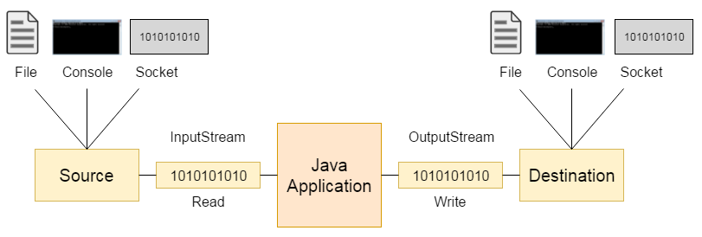
Notes:
We can read the data from the file and also we can write the data into the file
We can also read the data from the console and also we can write the data on to the file
Client server communications sending some signals and receiving some signals.

Slide 3
There are many classes and interfaces in the java.io package.
The java.io package provides classes and interfaces for input and output operations such as reading from and writing to files, console, memory, and network streams.

Slide 4
File
A File object is used to obtain or manipulate the information associated with a disk file.
Using a File object, we can obtain information such as:
      File name
      File path (absolute or relative)
      File size
      File permissions (read, write, execute)
      Date and time of last modification
      Whether it is a file or a directory
File class does not specify how information is retrieved from or stored in files;
It describes the properties of a file itself.

Slide 5
File
A directory in Java is treated simply as a File with one additional property:
List of filenames that can be examined by the list( ) method.
The list() method returns an array of String objects, where each element represents the name of a file or subdirectory present in that directory.
Notes:
The list() method returns an array of String objects, where each element represents the name of a file or subdirectory present in that directory. For regular files, this method returns null, since files do not contain other files.
Thus, a directory in Java is simply a File object that:
Represents a folder in the file system
Can be identified using isDirectory()
Allows examination of its contents using list()

Slide 6
Constructors used to create File objects:
File(String directoryPath) ex: File f = new File("C:/Data");
File(String directoryPath, String filename)
File(File dirObj, String filename) File dir = new File("C:/Data");
File f = new File(dir, "info.txt");
File(URI uriObj) When file locations are obtained from web resources
Notes:
The statement creates a File object representing the file info.txt located in the directory C:/Data. It does not physically create the file unless explicitly done using methods like createNewFile().
This constructor creates a File object using an existing File object representing a directory and a file name. It is commonly used when directory handling is already done using a File object.

Slide 7
Constructors used to create File objects:
File f1 = new File(“c:/mit/ict/cce/prg1.txt");
File f2 = new File(" c:/mit/ict/cce/", “prg1.txt”);
File f3 = new File(" c:/mit/ict/cce/");
File f4 = new File(f3,”prg1.txt”);

Slide 8
Windows:
recognize forward slash(/). Ex: "C:/Data/info.txt"
If we use backsword slash, we need to use escape sequence(\\)
        So to correctly write a Windows path in Java: "C:\\Data\\info.txt"
Unix :
Unix does NOT use backslash (\) for paths.
Forward slash (/) is the only directory separator.
example /home/user/data/info.txt.

Slide 9
Methods :
String getName() File f = new File("C:/Data/info.txt");
String getParent()
String getPath()
String getAbsolutePath()
Notes:
f.getName(); // "info.txt“
f.getParent(); // "C:/Data“
f.getPath(); // "C:/Data/info.txt“
If the file was created using a relative path, Java converts it to an absolute one. o/p same as getpath()

Slide 10
Methods :
boolean exists():Checks whether the file or directory actually exists on disk.
boolean canWrite(): Checks whether the program has permission to write to the file.
boolean canRead(): Checks whether the program has permission to read the file.
boolean isDirectory(): Checks whether the File object represents a directory (folder).
boolean isFile(): Checks whether the File object represents a normal file.
boolean isAbsolute(): Checks whether the file path is absolute or relative.
Notes:
A relative path specifies the file location relative to the current working directory of the program.
An absolute path gives the complete location of a file or directory, starting from the root of the file system.

Slide 11
Methods :
long lastModified(): Returns the time when the file was last modified
long length(): Returns the size of the file in bytes.
Notes:
These are important methods of the File class
Returns the time when the file was last modified.
🔹 Return value:
A long value
Represents milliseconds since January 1, 1970 (Epoch time)
______________________________________________________________________________________________________

Slide 12
Methods :
boolean renameTo(File newName)
        File oldFile = new File("C:/Data/info.txt");
        File newFile = new File("C:/Data/details.txt");
        oldFile.renameTo(newFile);
newName becomes the new name of the invoking File object.
It will return true upon success and false if the file cannot be renamed.
(if you either attempt to rename a file so that it uses an existing filename).
Notes:
info.txt ❌ (no longer exists)
details.txt ✅ (new name)
The renameTo() method returns false if the source file does not exist, if permissions are insufficient, or if an attempt is made to rename a file using a filename that already exists

Slide 13
Creating Directories
boolean mkdir( ) : Creates only one directory (single folder).
File f = new File("C:/Data/Test");
f.mkdir();
Works only if C:/Data already exists.
boolean mkdirs( )
mkdirs : To create a directory for which no path exists. It creates a directory and all the parents of the directory.
Notes:
File f = new File("C:/Data/Test");
f.mkdir();
Works only if C:/Data already exists.
_____________________
File f = new File("C:/Data/Test/Example");
f.mkdirs();
Data doesn’t exist
Test doesn’t exist
👉 mkdirs() will create:

Slide 14
Creating Directories
File f = new File("D:\\MIT");
if (f.mkdir())
{
System.out.println("Directory is created");
}
else
{
System.out.println("Directory cannot be created");
}

Slide 15
Boolean delete(): The delete() method of the File class is used to delete the file or directory represented by the File object.
To delete file and directory.
To delete directory, it should be empty

Slide 16
Directories
String [] list()
The list() method of the File class returns the names of files and subdirectories inside a directory.

Slide 17
The listFiles( ) Alternative
Variation to the list( ) method: list() gives only file names;
ex: ["info.txt", "data.txt"]
Which returns File instead of string; listFiles() gives File objects;
[File("C:/Data/info.txt"), File("C:/Data/data.txt")]
File[ ] listFiles( )
File[ ] listFiles(FilenameFilter FFObj)
Notes:
1️⃣ File[] listFiles()
👉 Meaning:
Returns an array of File objects representing
all files and subdirectories inside the directory.
___________________________________________________________________
File[] listFiles(FilenameFilter FFObj)
👉 Meaning:
Returns only those files that match a specific condition (filter).
It uses a FilenameFilter object to decide which files to include ex: .txt files etc..

Slide 18
Using FilenameFilter
To limit the number of files returned by the list( ) method.
To include only those files that match a certain filename pattern, or filter.
Second form of list( ) :
String[ ] list(FilenameFilter FFObj)
FFObj is an object of a class that implements the FilenameFilter interface.
Notes:
Returns only filtered file names (not File objects).;
FilenameFilter is an interface in java.io

Slide 19
FilenameFilter defines a single method, accept( ), which is called once for each file in a list.
boolean accept(File directory, String filename)
The accept( ) method returns true for files in the directory specified by directory that should be included in the list (that is, those that match the filename argument), and returns false for those files that should be excluded.
The OnlyExt class implements FilenameFilter.

Slide 20
import java.io.*;
public class OnlyExt implements FilenameFilter
{
String ext;
public OnlyExt(String ext)
{
this.ext = "." + ext;
}
public boolean accept(File dir, String name)
{
return name.endsWith(ext);
}
}
Notes:
OnlyExt is a class.
It implements the FilenameFilter interface.
So it must override the accept() method.
Java will:
Go through each file
Call accept() for each file
Include only files where accept() returns true

Slide 21
import java.io.*;
class DirListOnly
{ public static void main(String args[])
{
String dirname = "/java";
File f1 = new File(dirname);
FilenameFilter only = new OnlyExt("html");
String s[] = f1.list(only);
for (int i=0; i < s.length; i++)
{ System.out.println(s[i]);
}
} }
Notes:
If the directory /java does not exist, f1.list(only) will return null → program will throw NullPointerException.

Slide 22


A stream is a logical entity that either produces or consumes information.
A stream is linked to a physical device by the Java I/O system.
Notes:
Byte stream in Java reads or writes data byte by byte. It is used for binary files. InputStream is for reading bytes, and OutputStream is for writing bytes.

Slide 23
Notes:
Yes — in both cases the file ultimately stores data as bytes.
Whether you use:

Slide 24
Byte stream
File: "Hello"
Storage in File (Bytes):
+----+----+----+----+----+----+
| 72 |101 |108 |108 |111 | 10 |
+----+----+----+----+----+----+
H e l l o \n
|
| FileInputStream (reads one byte at a time)
v
Program Receives:
72 → 101 → 108 → 108 → 111 → 10
Notes:
FileInputStream reading: FileInputStream in Java is a byte stream. This means it reads one byte at a time from the file. It does not automatically convert bytes to characters — it just gives the numeric byte value.

Slide 25
Character stream
File: "Hello"
Storage in File (Bytes):
+----+----+----+----+----+----+
| 72 |101 |108 |108 |111 | 10 |
+----+----+----+----+----+----+
|
| FileReader (decodes bytes to characters)
v
Program Receives:
'H' → 'e' → 'l' → 'l' → 'o' → '\n'
Notes:
FileReader in Java is a character stream class used to read characters from files.
It decodes bytes from a file into characters using the platform's default character encoding (or a specified encoding if wrapped via InputStreamReader).

Slide 26
The Stream Classes
Java’s stream-based I/O is built upon four abstract classes:
InputStream: reads bytes from a file
OutputStream,: writes bytes to a file
Reader,: reads characters from a file
Writer. Writes characters to a destination.
Notes:
The difference is whether conversion is automatic (Writer) or manual (OutputStream).

Slide 27
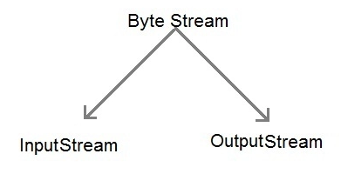
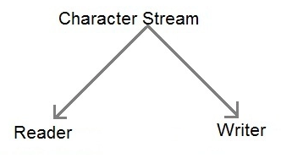
InputStream and OutputStream are designed for byte streams.
Reader and Writer are designed for character streams.
use the character stream classes when working with characters or strings, and use the byte stream classes when working with bytes or other binary objects.

Slide 28
The Byte Streams
Byte stream classes provide a rich environment for handling byte-oriented I/O.

Slide 29
InputStream
InputStream is an abstract class that defines Java’s model of streaming byte input.
Most of the methods in this class will throw an IOException on error conditions.

Slide 30
methods in InputStream.
int read( ): Reads one byte from the input stream.
Returns an integer representation of the next available byte of input.
Notes:
Reads one byte from the input stream.
Returns the byte as an int in the range 0–255.
Returns -1 if end of stream (EOF) is reached.

Slide 31
methods in InputStream.
int read( )
int read(byte buffer[ ]): Reads multiple bytes at once from the input stream into a byte array (buffer).
Attempts to read up to buffer.length bytes into buffer and returns the actual number of bytes that were successfully read.

Slide 32
methods in InputStream.
int read( )
int read(byte buffer[ ])
int read(byte buffer[ ], int offset, int numBytes)
Attempts to read up to numBytes bytes into buffer starting at buffer[offset], returning the number of bytes successfully read.
–1 is returned when the end of the file is encountered.
Notes:
offsetIndex: in your buffer array where bytes are stored
numBytes → the maximum number of bytes to read

Slide 33
methods in InputStream.
int available( ): number of bytes available to read without blocking
Returns the number of bytes of input currently available for reading.

Slide 34
methods in InputStream.
int available( )
long skip(long numBytes): Useful when you want to jump ahead in the stream without processing all the bytes.
Ignores (that is, skips) numBytes bytes of input, returning the number of bytes actually ignored.

Slide 35
methods in InputStream.
int available( )
long skip(long numBytes)
void close( )
Closes the input source. Further read attempts will generate an IOException.

Slide 36
methods in InputStream.
boolean markSupported( ): Marking means remembering the current position in the input stream
void mark(int numBytes): Save this position (Read limit)
void reset( ): Go back to saved position.
Returns true if mark( )/reset( ) are supported by the invoking stream.
Places a mark at the current point in the input stream that will remain valid until numBytes bytes are read.
Resets the input pointer to the previously set mark.
Notes:
Marking means remembering the current position in the input stream so that you can return to it later.

Slide 37
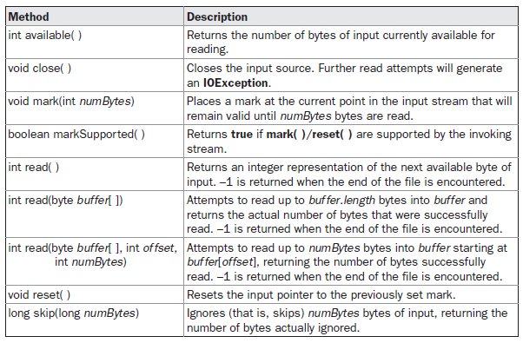
Table 19-1 shows the methods in InputStream.

Slide 38
OutputStream
OutputStream is an abstract class that defines streaming byte output.
Most of the methods in this class return void and throw an IOException in the case of errors.

Slide 39
methods in OutputStream.
void write(int b): Writes one single byte.
void write(byte buffer[ ]): Writes the entire byte array to the file.
void write(byte buffer[ ], int offset, int numBytes)
Writes a subrange of numBytes bytes from the array buffer, beginning at buffer[offset].
Notes:
offset refers to the starting index in the buffer (array) or Offset means position (index) in the buffer.
from where writing should begin.

Slide 40
methods in OutputStream.
void close( )
void flush( ): forces the buffered data to be written immediately to the destination
Closes the output stream. Further write attempts will generate an IOException.
Finalizes the output state so that any buffers are cleared.
Notes:
When you write data to a file or output stream, Java may temporarily store it in memory (buffer) instead of writing it immediately.
👉 flush.
() forces the buffered data to be written immediately to the destination

Slide 41
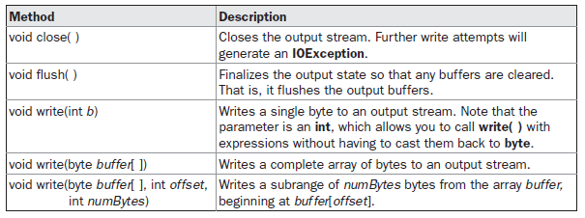
Table 19-2 shows the methods in OutputStream.

Slide 42
import java.io.*;
public class FileCopyExample {
public static void main(String[] args) {
try {
// Create InputStream to read from source file
FileInputStream fis = new FileInputStream("source.txt");
// Create OutputStream to write to destination file
FileOutputStream fos = new FileOutputStream("destination.txt");
int byteData;

Slide 43
// Read byte by byte until end of file
while ((byteData = fis.read()) != -1) {
// Write the byte to destination file
fos.write(byteData);
}
// Close the streams
fis.close();
fos.close();
System.out.println("File copied successfully!");
} catch (IOException e) {
System.out.println("Error: " + e.getMessage());
}
}
}

Slide 44
The Character Streams
Top of the character stream hierarchies are the Reader and Writer abstract classes.

Slide 45
The Character Streams
The byte stream classes provide functionality to handle any type of I/O operation, they cannot work directly with Unicode characters.
Character streams : direct I/O support for characters.
NOTE :
The character I/O classes were added by the 1.1 release of Java.
Because of this, we may still find legacy code that uses byte streams where character streams would be more appropriate

Slide 46
Reader
Reader is an abstract class that defines Java’s model of streaming character input.

Slide 47
Reader methods
int read( ): Reads one character from the stream
int read(char buffer[ ]): Reads multiple characters at once and
stores them in the buffer array.
int read(char buffer[ ], int offset, int numChars)
Returns an integer representation of the next available character from the invoking input stream.
Attempts to read up to buffer.length characters into buffer and returns the actual number of characters that were successfully read.
Attempts to read up to numChars characters into buffer starting at buffer[offset], returning the number of characters successfully read.
–1 is returned when the end of the file is encountered.
Notes:
Reads up to numChars characters from the file.
Stores them in buffer starting at index = offset.
Returns number of characters read, or -1 if EOF.

Slide 48
Reader methods
long skip(long numBytes)
void close( )
Skips over numChars characters of input, returning the number of characters actually skipped.
Closes the input source. Further read attempts will generate an IOException.

Slide 49
Reader methods
boolean markSupported( )
void mark(int numChars)
void reset( )
Returns true if mark( )/reset( ) are supported on this stream.
Places a mark at the current point in the input stream that will remain valid until numChars characters are read.
Resets the input pointer to the previously set mark.

Slide 50
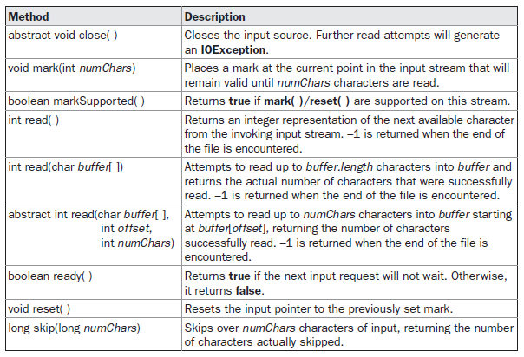
Table 19-3 provides a synopsis of the methods in Reader.

Slide 51
Writer
Writer is an abstract class that defines streaming character output.
All of the methods in this class throw an IOException in the case of errors.

Slide 52
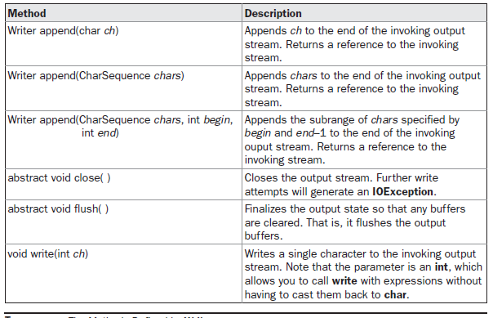
Table 19-4 shows a synopsis of the methods in Writer.

Slide 53
import java.io.*;
public class CharStreamExample {
public static void main(String[] args) {
try {
//Writing text to a file using FileWriter
FileWriter fw = new
FileWriter("textfile.txt");
fw.write("Hello World"); // write string
fw.close(); // always close writer
System.out.println("Text written to file.");

Slide 54
//Reading text from the file using FileReader
FileReader fr = new FileReader("textfile.txt");
int ch;
System.out.print("File content: ");
while ((ch = fr.read()) != -1) { // read one character at a time
System.out.print((char) ch); // cast int to char
}
fr.close(); // close reader
System.out.println("\nFile read successfully.");
} catch (IOException e) {
System.out.println("Error: " + e.getMessage());
}
}
}

Slide 55
Differences
Aspect | Byte Stream | Character Stream
Unit of Data | Byte (8 bits) | Character (16 bits, Unicode)
Data Type | Binary data | Text data
Encoding | No character encoding | Uses character encoding (UTF-8, UTF-16)
Base Classes | InputStream, OutputStream | Reader, Writer
Example Classes | FileInputStream, FileOutputStream | FileReader, FileWriter
Suitable For | Images, audio, video, PDFs | Text files, documents, logs
Portability | Lower for text | Higher for text
Conversion | No encoding conversion | Handles encoding/decoding

